Slide 1
Intelligence
Chapter 9

Slide 2
Intelligence
Gardner (1999) defined intelligence as
  a biopsychological potential to process information that can be activated in a cultural setting to solve problems or create products that are of value in a culture" (pp. 33-34).

Slide 3
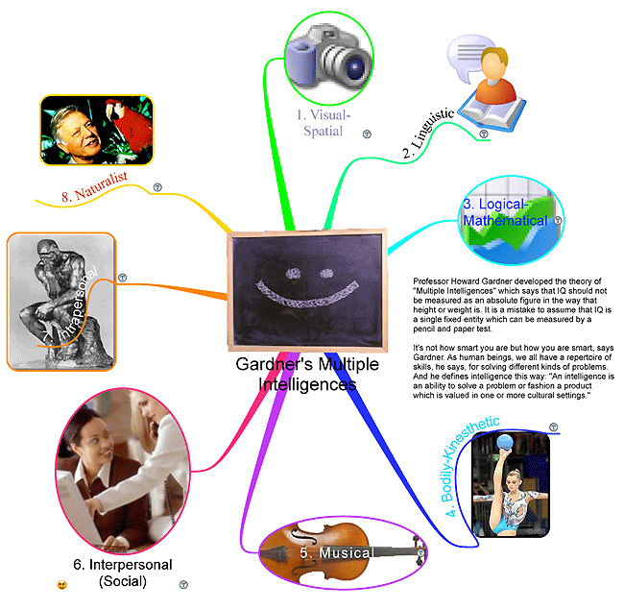
Multiple intelligences
  Page 322
  Share your intelligencewith your group

Slide 4

Intelligence
Intelligence
  Problem solving
  Reasoning
  Knowledge
  Memory
  Adaptation
    Measuring intelligence
      WAIS (Table 9.1, p. 307)
      IQ ranges (Table 9.3, p. 310)
      Culture-fair-test?

Slide 5
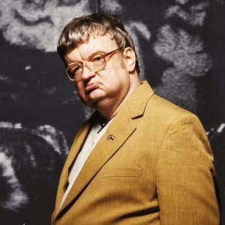
Intelligence
Savant Syndrome (page 314)
  Kim Peek
  Limited intelligence
  Exceptional mental ability
http://www.youtube.com/watch?v=NJjAbs-3kc8

